Slide 1
Parallelizing Dijkstra’s Algorithm
IT388 Introduction to Parallel Processing Resources
Fall 2018
Cain Wock
Matthew Hill
Cody Ponder
Deidre Brennan

Slide 2
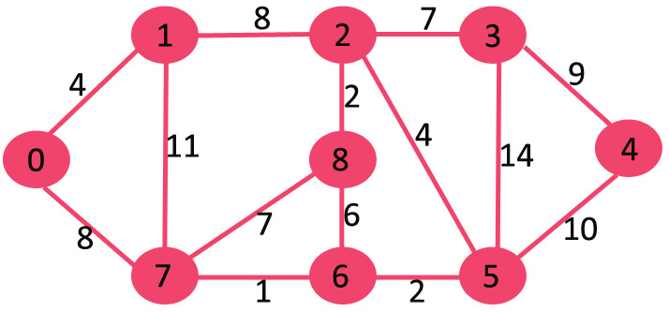
What is dijkstra’s Algorithm?
Dijkstras algorithm is for finding the shortest paths between nodes in a graph

Slide 3
How it works
Most implementations pick a “source” node and calculate the distance to other nodes.
By picking an unvisited vertex with the lowest distance, the algorithm calculates the distance through it to each unvisited neighbor and then updates the neighbors distance if it is smaller than the previous known distance.
Once a node has been visited, it will be marked so it cannot be visited again.

Slide 4
VISUAL AID
In this diagram, the root node is 1 and the destination node is 5
When the distance to a node has not yet been calculated, it is seen as infinite

Slide 5
Visual Aid
Node 2 is visited first because it has the shortest distance of 7
The distances of nodes 3 and 6 are then determined.

Slide 6
Visual Aid
Node 2 will be chosen as the new Base because it has the shortest distance
Node one will be marked so it can no longer be visited

Slide 7
Goals
Test a serial implementation of Dijkstra’s algorithm to create base run times
Code a parallelized implementation of Dijkstra’s algorithm
Analyze the parallelized implementation and examine what can be parallelized and what cannot.
Compare the serial vs. parallelized programs using their runtimes and determine if it is worth using parallelization

Slide 8
Aproach
The problem requires adjacent distances to be known when picking the next pivot node.
A node must have multiple connections in order for parallelization to be efficient
We will parallelize the process of finding distance to connected nodes for every pivot
Information will have to be given to a single process to pick the next node

Slide 9
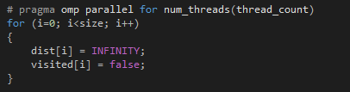
A walkthrough of the OpenMP Dijkstra’s program
ALL POINTS THAT HAVE NOT YET BEEN VISITED CAN BE SEEN AS INFINITELY FAR AWAY!

Slide 10
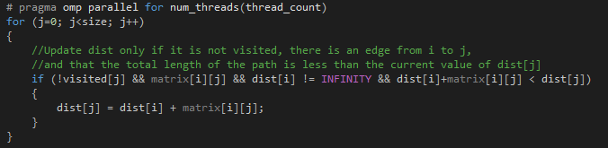
Updating the distance to other nodes is another factor that can be parallelized
A walkthrough of the OpenMP Dijkstra’s program

Slide 11

It can even be used for the initial memory allocation process

Slide 12
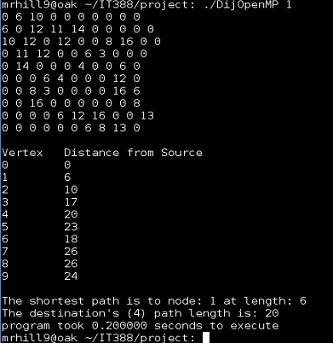
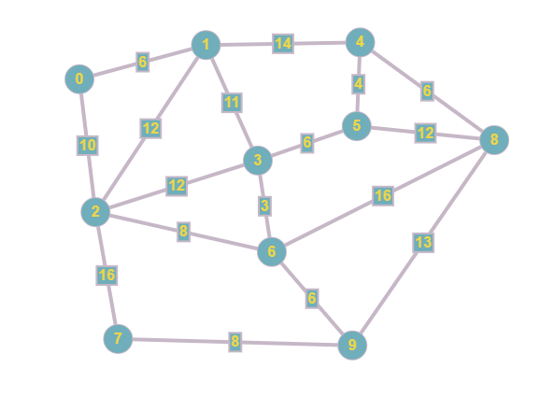
The material
It’s easy to visualize the connected graphs when they are small

Slide 13
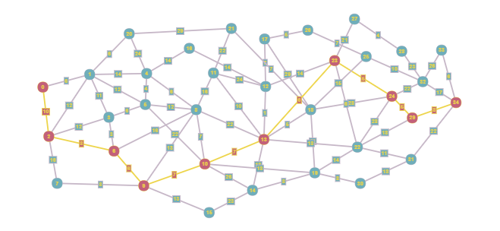
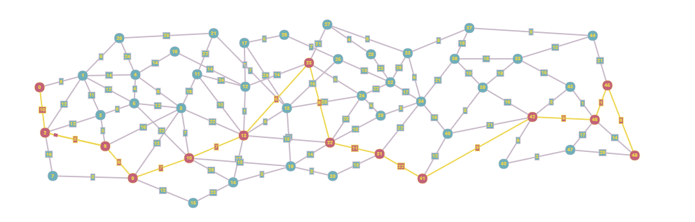
The larger you make the graph, the more difficult to understand the connections, We made these Custom
35 vertices
45 vertices

Slide 14
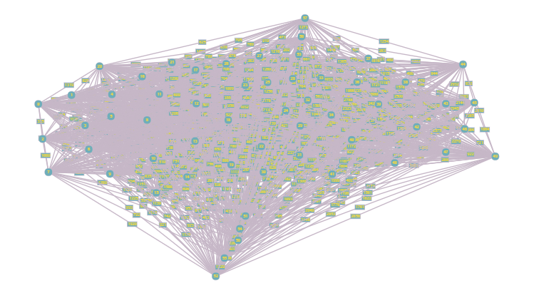

If you try to randomize points and connections it becomes difficult to visualize at all
57 vertices
Interconnected

Slide 15
Practical uses of Dijkstras algorithm
Network routing systems : Each point can represent a switch in a network
Finding a shortest path can help packets reach their destinations faster

Slide 16
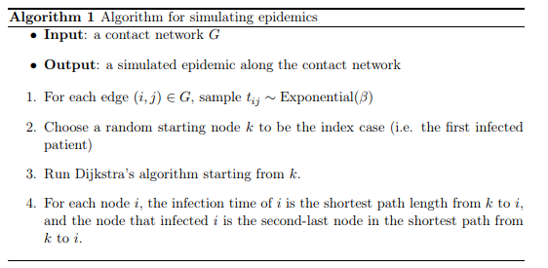
Tracking the Progress of an infectious disease

Slide 17
A* algorithm

Slide 18
Sources
Infectious diseases
Tracing Infectious Diseases using Genetic and Spatial Data Bryan Hooi Advisor: Susan Holmes Stanford University May 15, 2014
http://mathematics.stanford.edu/wp-content/uploads/2013/08/Hooi-Honors-Thesis-2014.pdf
Visual representation of graphs
http://graphonline.ru/en/
57 Node graph:
https://people.sc.fsu.edu/~jburkardt/data/graph_representation/graph_representation.html

